Slide 1
Distributed Deadlock Detection
Chandy, Misra and Haas
Presented by C Corley and K Coursey

Slide 2


Deadlock Problem
Kansas Legislature: when two trains approach each other at a crossing, both
shall come to a full stop and neither shall start up again until the other has gone.
Two processes exchange a long message with each other, but their socket buffer
is smaller than the message.
Process
A
message
message
Process
B
Socket
buffer
Socket
buffer

Slide 3
Deadlock Characterization
Deadlock can arise if four conditions hold simultaneously.
Mutual exclusion: only one process at a time can use a resource.
Hold and wait: a process holding resource(s) is waiting to acquire additional resources held by other processes.
No preemption: a resource can be released only voluntarily by the process holding it upon its task completion.
Circular wait: there exists a set {P₀, P₁, …, P₀} of waiting processes such that P₀ is waiting for a resource that is held by P₁, P₁ is waiting for a resource that is held by P₂, …, P_{n–1} is waiting for a resource that is held by P_{n}, and P_{n} is waiting for a resource that is held by P₀.

Slide 4
System Model
Resource types R₁, R₂, . . ., R_{m}
    CPU cycles, memory space, I/O devices
Each resource type R_{i} has W_{i} instances.
Each process utilizes a resource as follows:
  request
  use
  release

Slide 5
Resource Allocation Graph
Process
Resource Type with 4 instances
P_{i} requests instance of R_{j}
P_{i} is holding an instance of R_{j}
P_{i} releases an instance of R_{j}
P_{i}
R_{j}
The sequence of
Process’s recourse utilization
Request edge
P_{i}
Assignment edge
P_{i}
R_{j}

Slide 6

Resource-allocation graph
R₁
R₃
P₁
P₂
P₃
R₂
Can a deadlock happen?
R₄

Slide 7

Resource Allocation Graph With A Deadlock
There are two cycles found.

Slide 8

Resource Allocation Graph With A Cycle But No Deadlock
If graph contains no cycles ⇒ no deadlock.
If graph contains a cycle ⇒
  if only one instance per resource type, then deadlock.
  if several instances per resource type, possibility of deadlock.

Slide 9
Two types of deadlocks
Resource deadlock: uses AND condition.
AND condition: a process that requires resources for execution can proceed when it has acquired all those resources.
Communication deadlock: uses OR condition.
OR condition: a process that requires resources for execution can proceed when it has acquired at least one of those resources.

Slide 10
Deadlock conditions
The condition for deadlock in a system using the AND condition is the existence of a cycle.
The condition for deadlock in a system using the OR condition is the existence of a knot.
A knot (K) consists of a set of nodes such that for every node a in K, all nodes in K and only the nodes in K are reachable from node a.

Slide 11
Example: OR condition
P3
P3
P1
P2
P4
P4
P1
P2
P5
P5
No deadlock
Deadlock

Slide 12
DS Deadlock Detection
Bi-partite graph strategy modified
  Use Wait For Graph (WFG or TWF)
    All nodes are processes (threads)
    Resource allocation is done by a process (thread) sending a request message to another process (thread) which manages the resource (client - server communication model, RPC paradigm)
  A system is deadlocked IFF there is a directed cycle (or knot) in a global WFG

Slide 13
DS Deadlock Detection, Cycle vs. Knot
The AND model of requests requires all resources currently being requested to be granted to un-block a computation
  A cycle is sufficient to declare a deadlock with this model
The OR model of requests allows a computation making multiple different resource requests to un-block as soon as any are granted
  A cycle is a necessary condition
  A knot is a sufficient condition

Slide 14
Deadlock in the AND model; there is a cycle
but no knot
No Deadlock in the OR model
P1
P3
P2
S1
P6
P4
P8
P5
P9
P7
P10
S2
S3

Slide 15
Deadlock in both the AND model and the OR model;
there are cycles and a knot
P1
P3
P2
S1
P6
P4
P8
P5
P9
P7
P10
S2
S3

Slide 16
Methods for Handling Deadlocks
Ensure that the system will never enter a deadlock state.
Allow the system to enter a deadlock state and then recover.
Ignore the problem and pretend that deadlocks never occur in the system; used by most operating systems, including UNIX.

Slide 17
Deadlock Prevention
Restrain the following four conditions
Mutual Exclusion – not required for sharable resources. (but not work always.)
Hold and Wait – must guarantee that whenever a process requests a resource, it does not hold any other resources.
  Require a process to request and be allocated all its resources before its execution: Low resource utilization
  Allow process to request resources only when the process has none: starvation possible.
No Preemption –
  If a process holding some resources requests another resource that cannot be immediately allocated to it, all resources currently being held are released.
  If a process P1 requests a resource R1 that is allocated to some other process P2 waiting for additional resource R2, R1 is allocated to P1.
Circular Wait – impose a total ordering of all resource types, and require that each process requests resources in an increasing order of enumeration.

Slide 18

Deadlock Avoidance
Let processes supply OS with
future resource requests
Cycle possibly formed (unsafe state),
thus P2 has to wait for a safe state
Claim edge (future request)

Slide 19
DDD Control Framework
Approaches to DS deadlock detection fall in three domains:
  Centralized control
    one node responsible for building and analyzing a real WFG for cycles
  Distributed Control
    each node participates equally in detecting deadlocks … abstracted WFG
  Hierarchical Control
    nodes are organized in a tree which tends to look like a business organizational chart

Slide 20
Intro to the Distributed World: Fantasy #1
In a world of complete information with a central information deadlock detection would be easier.
Much harder when
  No Central agent
  Direct communication between processes

Slide 21
Intro to the Distributed World: Fantasy #2
If only message communication were instantaneous, or even there were certain limits on message delays then life (deadlock detection) would be so much easier
Reality: You can only assume messages delay are arbitrary BUT finite.

Slide 22
Intro to the Distributed World: Assumptions
No central agent
Message delays are arbitrary but finite
Messages sent by process A to process B will get to B in the order they were sent to A

Slide 23
Model of Distributed Computation
Matches Dijkstra message protocol assumptions
  Any message sent by one process will be received correctly by another after an arbitrary delay, and arrive in FIFO order
  You can assume a message sent will eventually get to its destination, but can’t be sure that actually has unless you get an ack
  No waiting to send

Slide 24
Variation from computation termination detection
Dijkstra defusing computation
  One initiator that sends one or more messages. Processes other than the initiator can send only after receiving a message.
  Each process is ready to receive messages from ANY other process at all times
  Termination only when every process is idle waiting to receive a message from some other process.

Slide 25
Communications Model
Support use of CSP
A process must wait for some set (not necessarily all) other processes
Any process can send a message without first having to receive one.
Result: must detect deadlock when any subset of processes are waiting for each other.
In Dijkstra case, termination is when ALL processes are waiting for ALL others.

Slide 26
Basic Resource Model
Resource Based Deadlock
  Deadlock because process must wait permanently for resources held by each other
  A process which requesting resources must wait until it acquires all the resources before it can proceed.
  Strictly AND-based logic

Slide 27
Resource Model - (in Distributed DataBase)
A DDB consists of
  Resources
  Controller: manages resources and allocates them to specific process.
  Processes : can only access resources from its own controller
A controller can communicate with other controllers to allocate foreign resources
A process can only execute when it acquires ALL the resources its is waiting for
A process is idle it is waiting to acquire a resource, otherwise it is executing

Slide 28
Resource Model - (in Distributed DataBase)
Dependent(J,K) : when there exists a sequence Pj …. Pk where each process in the sequence is idle and each process except the first holds a resource the previous process needs
LocallyDependent(J,K) : all the dependent processes belong to one controller
If Dependent(J,K) then Pj must be idle at least as long as Pk
If Dependent(J,J) then DeadLocked(J)
If Dependent(J,X) and Dependent(X,J) then DeadLocked(J)

Slide 29
Dependent set S
Pb
Pj
Pa
Pc
Pk
Pd

Slide 30
DeadLock in Set S
Pb
Pj
Pa
Pc
Pk
Pd

Slide 31
Resource Model - (in Distributed DataBase)
Deadlock only exists if there is a cycle of idle processes each dependent on the other (otherwise one would finish and all processes in the chain would complete)
The GOAL : detect deadlocks if and only if such cycles exist

Slide 32
Basic Communication Model
Communication Based Deadlock
Requests can be in any logical sequence
  Example: Process P needs A AND (B OR C)
  If process P gets A and B it can cancel its request for C
After getting any any one resource in an OR the system can send cancels for the others in the disjunction

Slide 33
Communication Model
Abstract description of a network of communicating processes using message passing
  No explicit central controller or resources
  All coordination via messages
Associated with each idle process is its dependent set
  It starts executing on receiving a message from any member of its dependent set
  Otherwise it does not change state from idle (infinite patience) , it does not change its dependent set (non-psychotic)
A process is terminated if it is idle AND its dependent set is empty

Slide 34
Communication Model
Deadlock : a non-empty set S of processes is deadlock IF all processes in S are permanently idle.
A process is permanently idle if it never receives a message from any member in its dependent set
  Remember: processes have infinite patience and are non-forgetful

Slide 35
Communication Model
We could get into a halting problem situation if we have to look inside the processes to determine if a message is sent… so we don’t!
A non-empty set of processes S is deadlocked if and only if
  All processes in S are idle
  The dependent set of Every process in S is a subset of S
  There are no messages in transit between processes in S

Slide 36
Communication Model
A member of S must remain permanently idle (deadlocked) because
  A process P in S can only start executing when it gets a message from another member of its dependent set
  Every member of P’s dependent set that is in S cannot sent a message while remaining in the idle state
  There are no messages in transit so P will never get a message from a member of its dependent set in S

Slide 37
Comparison of the two models
In Communication model a process can know which processes it must receive a message from to continue
  If Pa needs a message from Pb then Pa knows its waiting for Pb
  Means that by the power of collective reasoning you could find deadlock
In Resource model dependence of one transaction on the actions of another transaction are not directly known
  What is know is a transaction is waiting on a resource, or a transaction holds a resource
  The controller has this information and so the controllers must reason together to detect deadlock
Deadlock detection responsibility lies in different places
  In Communication is every process responsibility
  In Resource is a concern of only a few elite nodes

Slide 38
Comparison of the two models
In Resource model a process cannot proceed unless it receives all resources it is waiting for
In Communication model a process cannot proceed until it can communicate with at least one of the processes it is waiting for
Difference : Wait for all resources Or wait for any one message
Which is better for your application?

Slide 39
Resource Deadlock Model : Probe Computation
The Controller of an idle process initiates a probe computation.
Controllers send probe messages between themselves to determine deadlock
Process k receives the message probe( i, j ,k), meaning
  Process j is idle
  The Process j is waiting for Process k ,
  The Process j knows that Process i is dependent Process j
Process k accepts probe (i, j and k) when
  Process k is idle ,
  Process k did not know Process i was dependent on it
  Process k can now deduce Process I is dependent on it
If Process i accepts a probe ( i, j , i ) then Process i is deadlocked

Slide 40
Resource Deadlock Model : Probe Computation
INSERT ALGORITHM 3.1 HERE

Slide 41
And now!
Cartoons and illustrations on DDD

Slide 42
Edge Chasing Algorithms
Chandy-Misra-Haas Algorithm (an AND model)
  probe messages M(i, j, k)
    initiated by Pj for Pi and sent to Pk
    probe messages work their way through the WFG and if they return to sender, a deadlock is detected

Slide 43
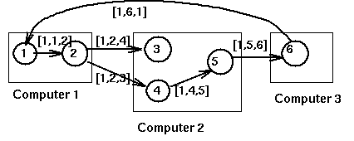
P1 requests a resource held by process P2

Slide 44
Diffusing Based : Example
for OR request model
processes are active or blocked
A blocked process may start a diffusion.
if deadlock is not detected, the process will eventually unblock and terminate the algorithm
message = query (i,j,k)
  i = initiator of check
  j = immediate sender
  k = immediate recipient
reply = reply (i,k,j)

Slide 45
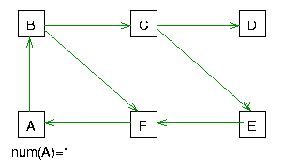
OR model :
On receipt of query(i,j,k) by m
if not blocked then discard the query
if blocked
  if this is an engaging query
  propagate query(i,k,m) to dependent set of m
  else
    if not continously blocked since engagement then discard the query
    else send reply(i,k,j) to j

Slide 46
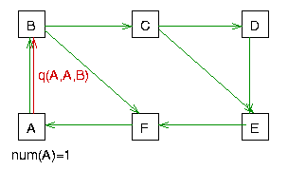
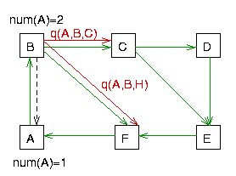
OR model :
On receipt of query(i,j,k) by m

Slide 47
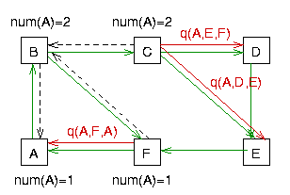
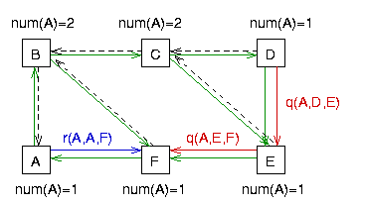
OR model :
On receipt of query(i,j,k) by m

Slide 48
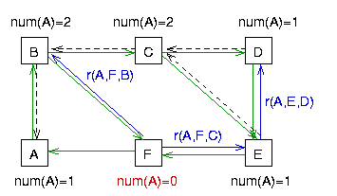
OR model
On receipt of reply(i,j,k) by k
if this is not the last reply
then just decrement the awaited reply count
if this is the last reply then
  if i=k report a deadlock
  else send reply(i,k,m)
  to the engaging process m

Slide 49
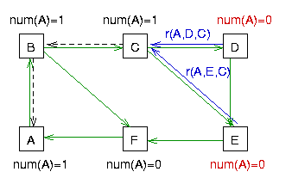
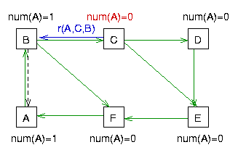
OR model
On receipt of reply(i,j,k) by k
The black dashed arrows indicate the engaging process for each engaged process. This information is needed to route the reply when the number of other processes for which the engaged process is waiting goes to zero.

Slide 50
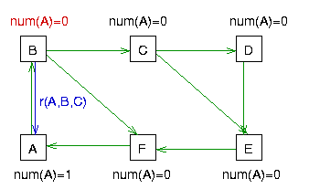
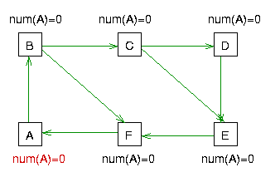
OR model
On receipt of reply(i,j,k) by k
Observe that the engaging process arrows form a spanning tree of the subgraph corresponding to the set of process for which the initiating process is waiting. If every process in this subgraph is blocked, we have a knot.
Knot detected !

Slide 51
Resource Deadlock Model : Probe Computation
When a controller detects one of its managed processes is deadlocked, it can inform all other processes via their controllers that they are deadlocked too

Slide 52
Distributed Deadlock Detection Algorithm: The Short Form
When a process has to wait for a resource (blocks), it sends a probe message to process holding the resource
Process can request (and can wait for) multiple resources at once
Probe message contains 3 values: (initiator, sender, receiver)
  ID of process that blocked
  ID of process sending message
  ID of process message was sent to
  (unclear why the latter two identifiers are necessary)
When a blocked process receives a probe, it propagates the probe to the process(es) holding resources that it has requested
ID of blocked process stays the same, other two values updated as appropriate
If the blocked process receives its own probe, there is a deadlock
size of a message is O(1)
“Detection as Distributed Breath First Search for Self”

Slide 53
Complexity
given n processes,
  a process may be blocked by up to (n-1) processes, the next process may be blocked by another (n-2) processes and so on.
  If there is more sites than processes, the worst case the number of messages is n(n-1)/2.
  If there are fewer sites m than processes then the worst case estimate is N2(N-M)/2M
size of a message is 3 integers

Slide 54
The End / OR is it deadlock?
We are now entering the idle state , waiting for a message from any of the other processes in the room !
Don’t make us send out probes!

Slide 55
Thanks!!

Slide 56
Distributed Deadlock Detection Algorithm: The Long Form
Deadlock detection algorithm
Initiate
  The Idle the Process which is to condition does the initiate.
  1 it increases the query computation number which oneself starts first.
  Oneself the message the wait sends the query message (i, m, i and j) which has the querycomputation price which increases with all process j whichit is doing.
  It stores the possibility of sending query message to the num [ i ].
Executing process
  Against all i it changes the wait [ i ] with the false.
  The process which is in the process of executing all query disregards message which come and reply message in oneself.
When idle process k receive query (i, m, j and k)
  M price the latest [ i ] it sees the case which will grow
    It is a query message against the query computation new initiative.
    latest [ i ]: = M and engager [ i ]: = j and wait [ i ]: = It stores a price with the true.
    Oneself the wait sends query message (i, m,k and r) with all processr which and it is doing with to advance query computation it goes out.
    It stores the query message possibility of sending to the num [ i ].
  wait [ i ] =true and, m=latest [ i ] one case
    Currently with the query computation which is in the process of advancing compared to above there was not a necessity which which it tries to advance in the course which corresponds and to know the thing it became.
    The reply it sendsthe message (i, m, kand j) with process j.
When idle process k receive reply (i, m, r and k)
  M = latest [ i ] and wait [ i ] = at the time of true one
    The reply message must wait one the num [ i ] which decreases as 1 reduces a price.
    num [ i ] = 0th time that there is a deadlock which when is a process where oneself starts the query computation it hands down a decision.
    If it is not like that and it sends replymessage (the i, m, the k and engager [i ]).

Slide 57
Communication Based Deadlock Model
Query computation
The Query with the message(i, m, j andk) there is a Reply message (i,m, k and j) which is confrontto that place.
  The Process the i m is the query computation which it starts.
  The Process the i already after starting query computation, the message from the different piece receives with to accomplish a work and it waits the message again and there is when, query computation and and again it is accomplished,, the hazard m price which the query computation of that cranium distinguishes to a idle condition and is necessary.
  The different point field with resourcemodel is similar.
  The Deadlock when searching an occurrence possibility from, the Reply message occurs
The Query when the Process i which, starts the computation all receiving the reply message against all query message which oneself sends it is to deadlock condition and to know it becomes
The arrangements which each process are having
  latest [ i ]: The Process the query computation number which the i starts recently
  engager [ i ]: The Process the process number which sends the query of the query computation which the i starts recently to oneself. The reply when sending the message, it is used.
  num [ i ]: The Process it corresponds to the query computation which the i starts recently and the possibility of drawing out the reply message possibility of receiving from the query message possibility oneself sending
  wait [ i ]: After oneself who amends the Latest (i) continuously at the time of idle condition one it has a true price

Slide 58
Resource example of deadlock
The Idle the controller of the machine 1 which is the process 0 which is to condition starts probe computation.
This time process 0 the dependent does the controller of machine 1 sends probe message (0, 1, 2) with machine 2 inthe process 2 which isto the different machine.
The Machine it receives2 (0,1, 2) and the process 2 the dependent sends with probe message (0, 3, 5) (0, 4,6) withthe machine 3 where isone process 5and a process 6.
The Machine against3 (0,3, 5) it sends probe messabe (0, 7, 0) with the machine 0 where the process 7is a dependentone process 0.
The Machine it receives1 and (0,7, 0) that it is to deadlock condition, it hands down a decision.

